Slide 1
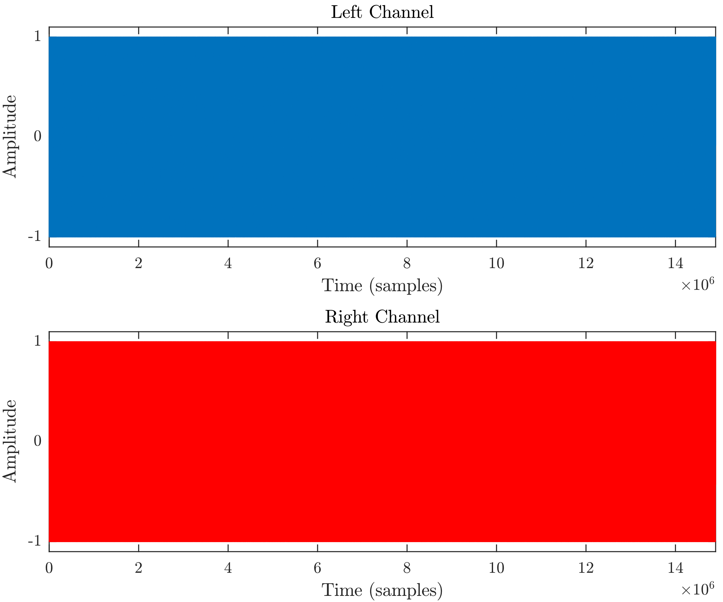
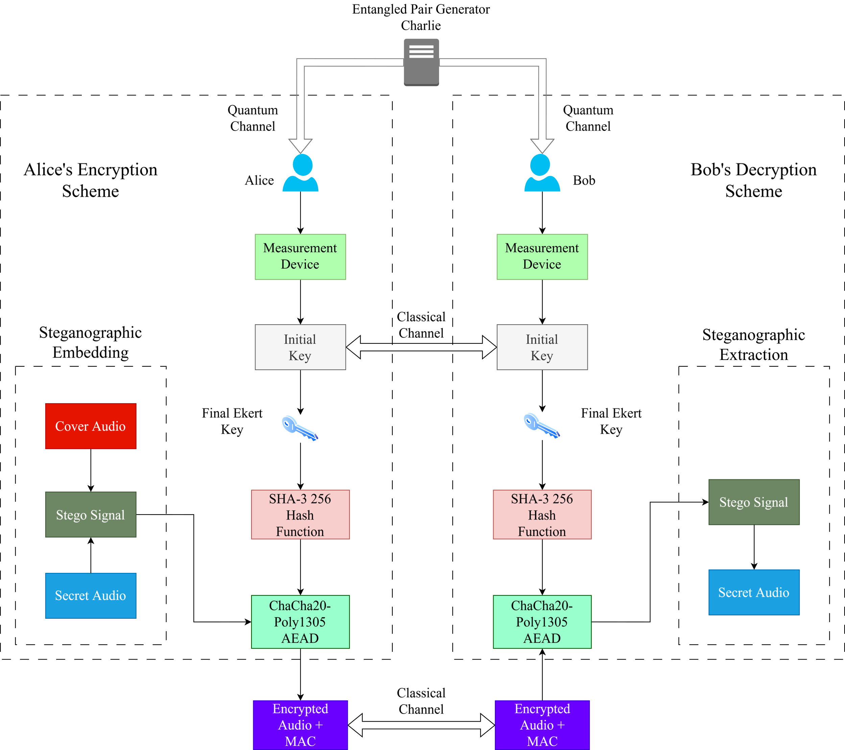
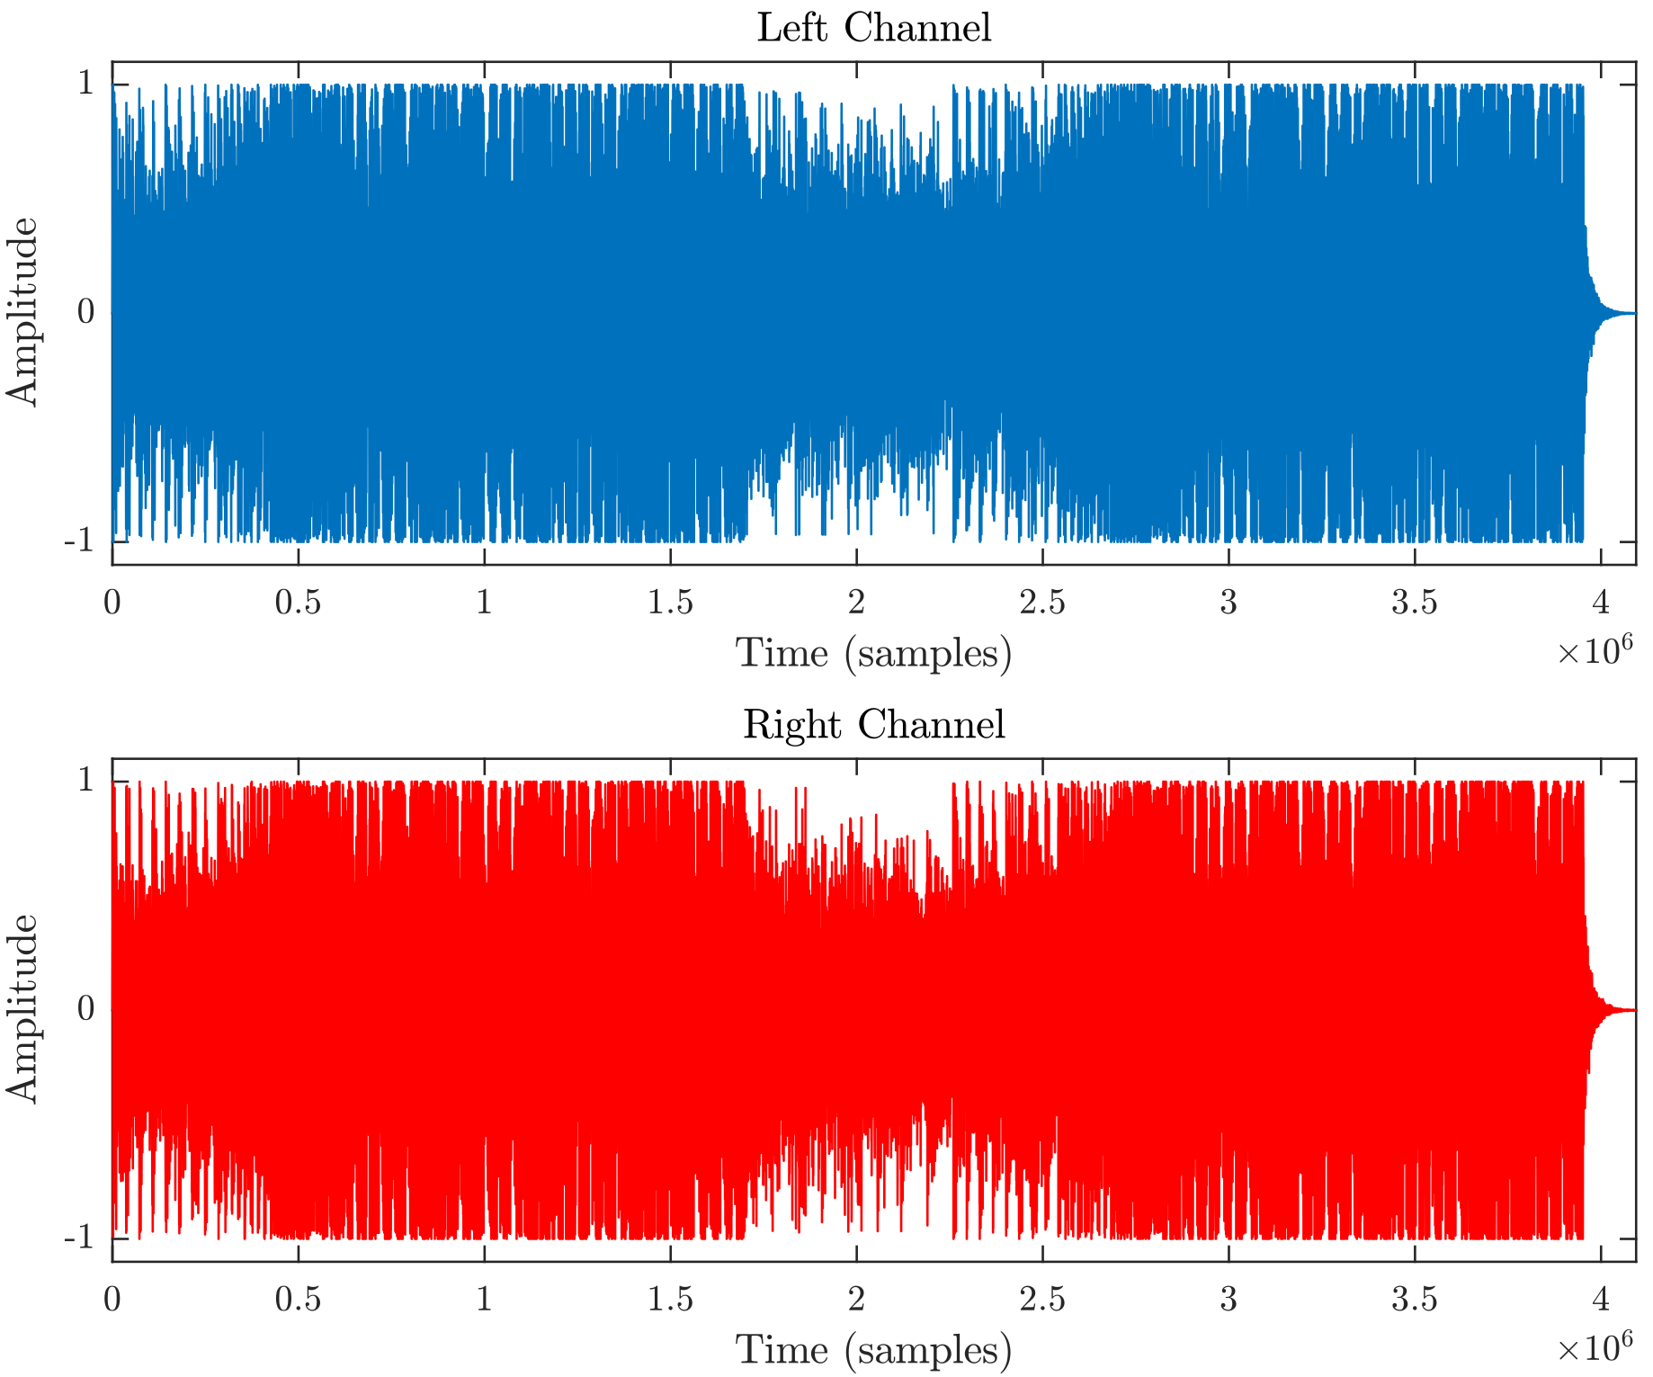
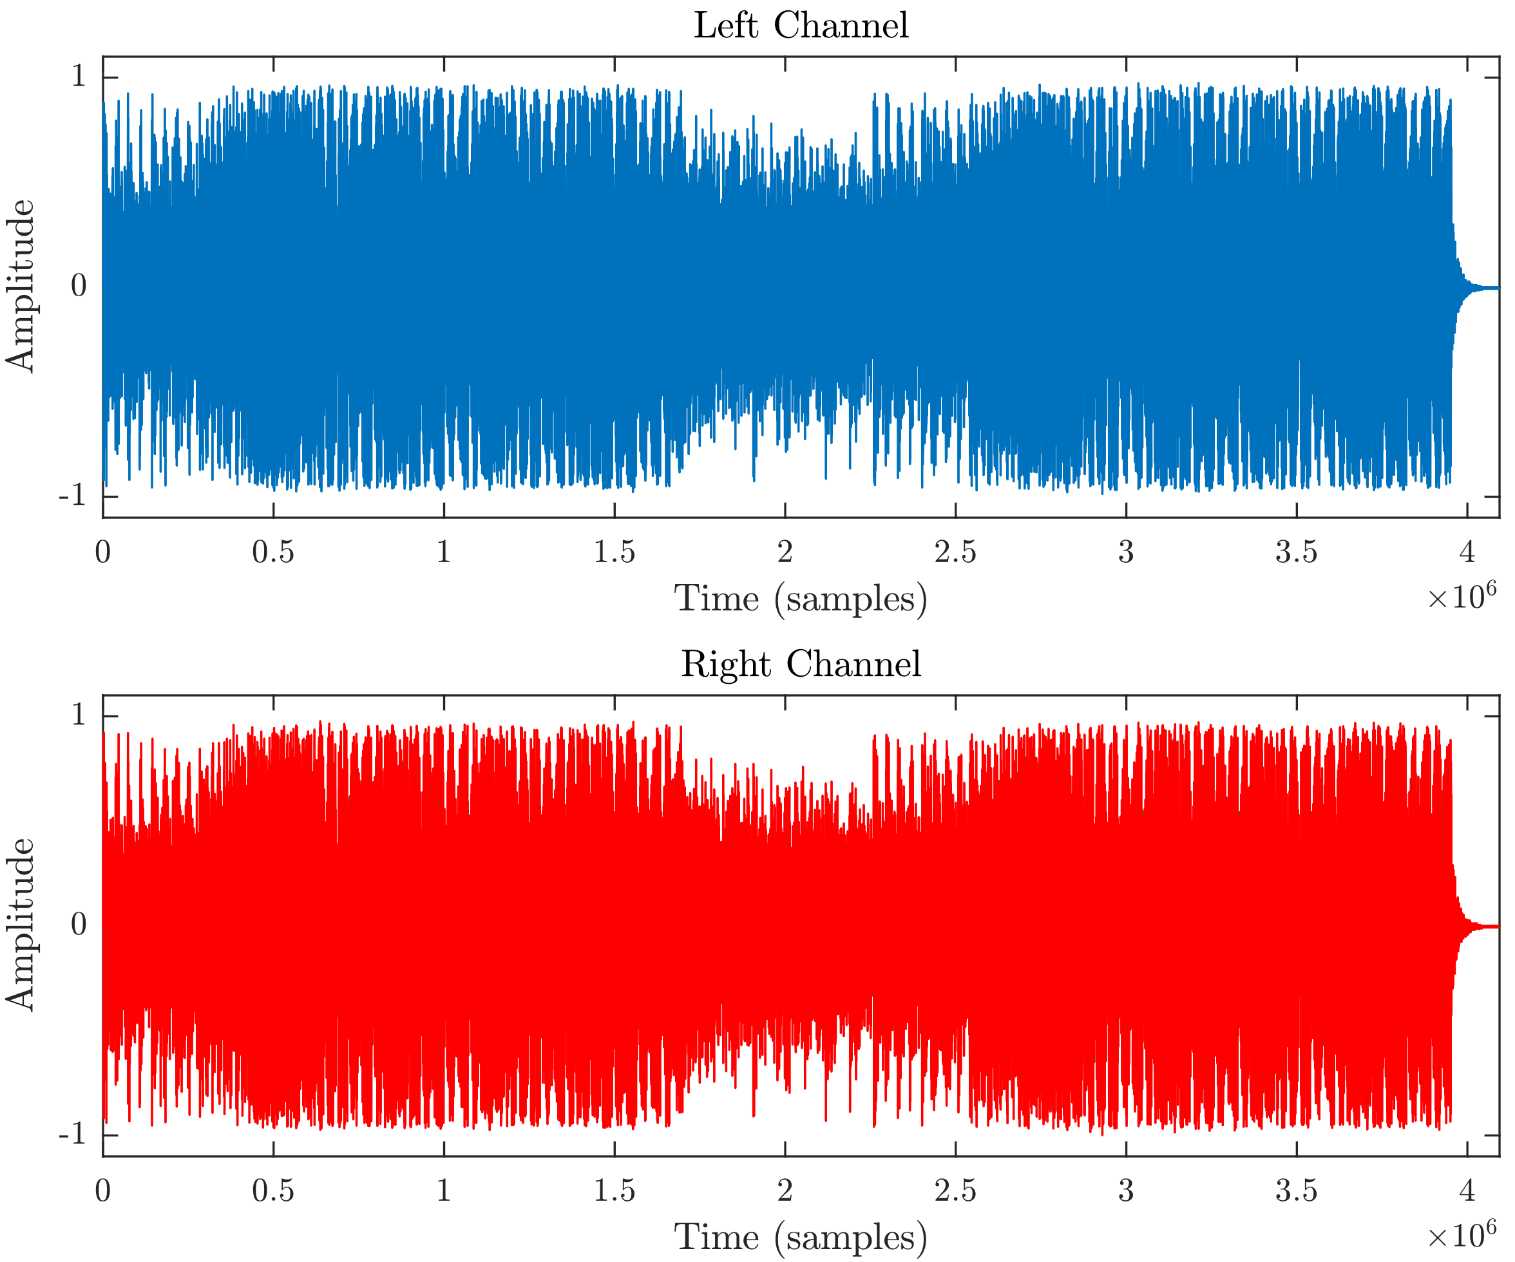
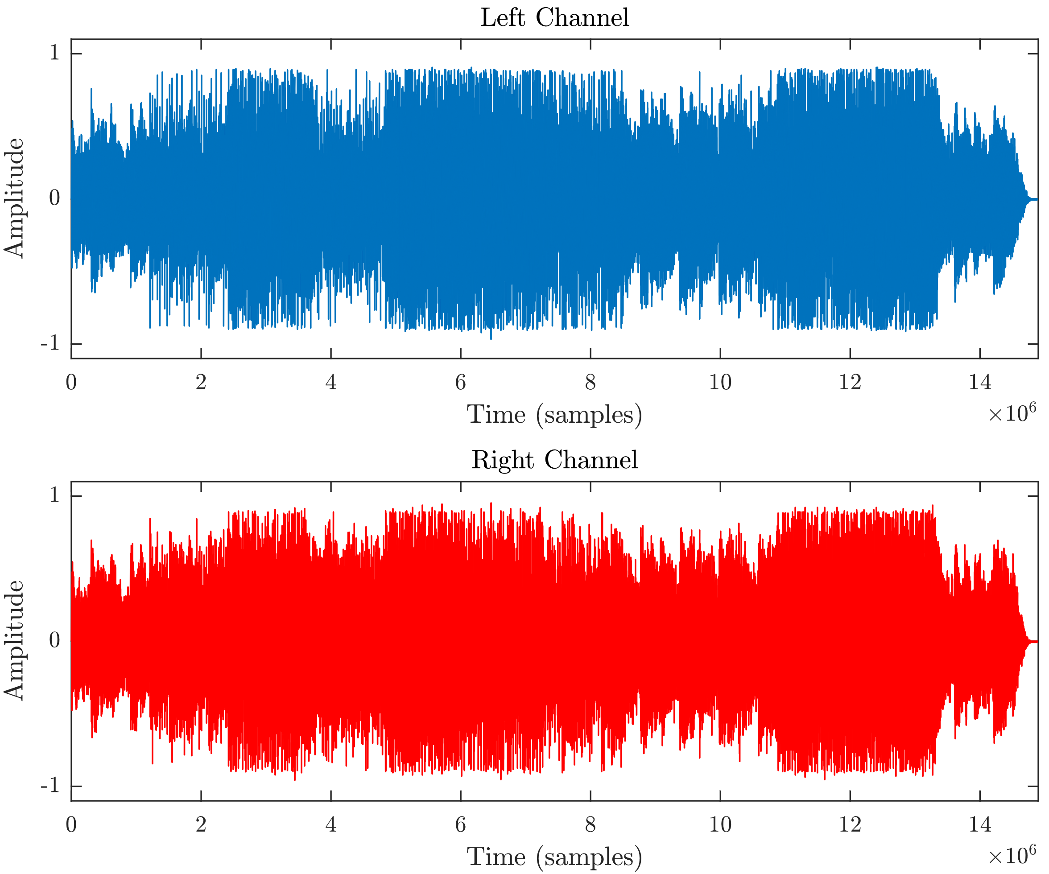
A NOVEL APPROACH OF SECURE AUDIO TRANSMISSION IN POST-QUANTUM ERA
Md. Raisul Islam Rifat¹, Md. Mizanur Rahman², Md. Abdul Kader Nayon¹, Md Shawmoon Azad³ and M.R.C. Mahdy³, *
¹Department of EEE, Chittagong University of Engineering And Technology ²Department of CSE, Rajshahi University of Engineering And Technology ³Department of Electrical and Computer Engineering, North South University, Bashundhara, Dhaka
Abstract:
The emergence of quantum computing possesses a significant security threat to the current classical system since it has the potential to outperform the current classical computer in some specific task due to their unique principle of operation. This necessitates finding a method which is resistive to quantum computers to securely transfer information. This research addresses these challenges by proposing a novel method combining quantum key distribution (QKD), specially E91 protocol with the classical encryption-authentication protocol i.e. Chacha20-Poly1305 and concealing information within another message through steganography to securely transfer audio messages.
Methodology:
The architecture that we proposed is a system that integrates E91 QKD protocol with classical cryptographic schemes and lsb steganography to ensure a heavily secure audio data encryption system. The system utilizes the E91 for QKD to generate and exchange the cryptographic keys called the Ekert key, SHA3 to derive a high-entropy 256-bit key from the Ekert key for ChaCha20-Poly1305 encryption and LSB substitution for steganography. The architecture ensures augmented data security through the combination of classical and quantum techniques. Figure 7 provides a high level overview of our proposed system.
 | Without Tampering | With Tampering
Sender end | Nonce: 5e4ef364b086ab3e2d1118cb Tag: 416c6c92659047d2f0660c36f58c1fa5 | Nonce: 5e4ef364b086ab3e2d1118cb Tag: 416c6c92659047d2f0660c36f58c1fa5
Receiver end | Nonce: 5e4ef364b086ab3e2d1118cb Tag: 416c6c92659047d2f0660c36f58c1fa5 | Nonce: ---------------------------- Tag: ------------------------------
Operation status | Verification successful! Decryption successful! | Verification failed! Decryption failed!
Introduction:
With the rise of the Internet, the amount of information exchanged through audio signals increased rapidly. This increase number audio transmission resulted in the development of different encryption techniques and cryptographic algorithms. The most popular among these algorithms are the symmetric AES and the asymmetric RSA encryption schemes. However, with the advent of Quantum Computers with increasing number of functional qubits, these classical cryptography and encryption schemes face an imposing threat. To address these arising challenges, new research is being done on the field of quantum augmented communication systems. One of the most promising area of research in the field of quantum communications is Quantum Key Distribution (QKD). QKD protocols works by establishing a secure cryptographic key between two users over an insecure channel. In resemblance, the research being done on the field of steganography heralds the emergence of an effective information concealing technique to obscure sensitive information within seemingly harmless transmission. Steganography is the technique of hiding secret massage within another massage in such a manner that it is not discernible that a secret message is embedded. This paper introduces a novel approach to reinforce the security of digital audio communication by combining the competency of QKD, classical encryption schemes and steganography.
Table-02: Tampering Analysis
Figure-03: Waveforms of the Encrypted audio produced by encrypting the Embedded audio.
Figure-01: Waveforms of Secret message audio.
Figure-04:Waveforms of the Extracted audios produced through decryption and LSB extraction.
Conclusion And Future Work:
Our proposed approach provides high security and robustness in case of audio transmission. It also sustainable under different types of attack. Still, we can modify the QKD protocol or steganographic process or transmitting text, images by filtering our model to get a better result in future.
Objectives:
Proposed an original architecture that successfully combines E91 QKD protocol, ChaCha20-Poly1305 AEAD and audio steganography using LSB.
Utilized E91 as the key distribution protocol which employs principles of quantum mechanics for secure key exchange.
Assimilated audio steganography using LSB substitution into the architecture to augment the security and robustness of the overall system.
Assessed the performance and reliability of the proposed scheme by measuring the security through end-to-end encryption.
Figure: Workflow of our proposed approach
Result Analysis:
Iteration | Key length | No. of Mismatched Bits | CHSH | Eve’s Knowledge of Alice’s key | Eve’s Knowledge of Bob’s key
1 | 126 | 16 | 1.229 | 88.1% | 96.03%
2 | 142 | 12 | 1.346 | 93.66% | 93.66%
3 | 243 | 32 | 1.37 | 93.83% | 90.53%
4 | 44 | 7 | 1.48 | 95.45% | 84.04%
References:
K. Ekert, “Quantum cryptography based on bells theorem,” Physical review letters, vol. 67, no. 6, p. 661, 1991
M. J. Dworkin, “Sha-3 standard: Permutation-based hash and extendable-output functions,” 2015.
D. J. Bernstein, “The chacha family of stream ciphers,” DJ Bernsteins webpage: http://cr. yp. to/chacha. html, 2008.
S. P. Yalla, S. Hemanth, S. T. Kumar, S. Moulali, and S. Dileep, “Novel text steganography approach using quantum key distribution: Survey paper,” NeuroQuantology, vol. 20, no. 13, p. 923, 2022.
Table-01: CHHR value in presence of eavesdropper.
Figure-02: Waveforms of Embedded audio produced through LSB Steganography.

